Slide 1

CASE STUDY : E-COMMERCE DATA

Slide 2

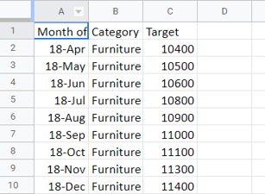
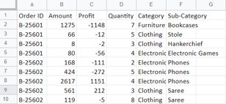
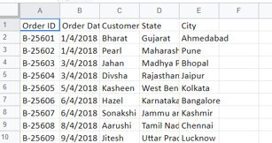
INTRO ABOUT DATA
We have 3 dataset :-
List of Orders
Order Details and
Sales Target

Slide 3
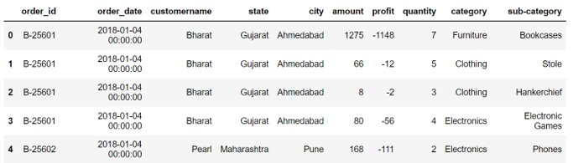
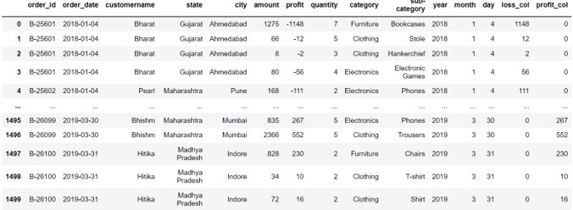
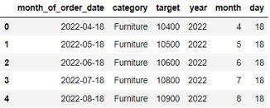

Final Datasets
2 Data Set to perform analysis.
1.For Sales Trend Analysis.
2.Another for Sales target analysis.
-> New Columns -
Day , Month , Year , loss_col , profit_col

Slide 4
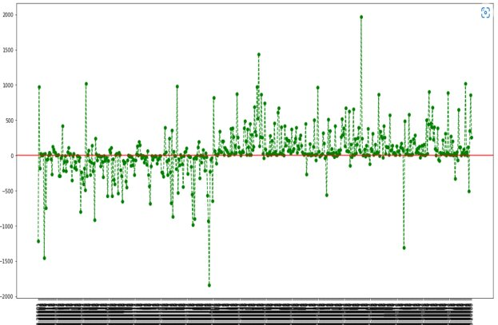
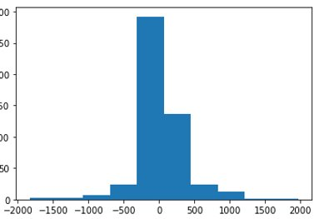
Profit based on Order ids
graph clearly show that very few orders are able to make profit above 500 .
Only 31 orders out of 500 orders are able to make profit above rs. 500.
Order ids having loss are 170.
299 Order ids are between 0 and 500

Slide 5

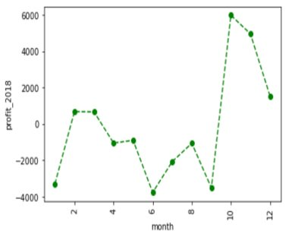
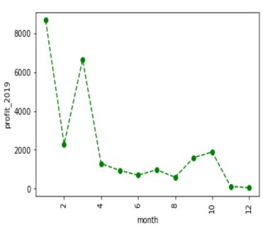
Monthly Profit/loss Analysis
sudden dip in the month of Februrary .
Decrease in profit after march till december
A bit profit rise in the period of august to October.
started in loss in the initial months
Total Profit increased gradually in the end of year but we experienced a sudden dip in total profit after the month of October .

Slide 6

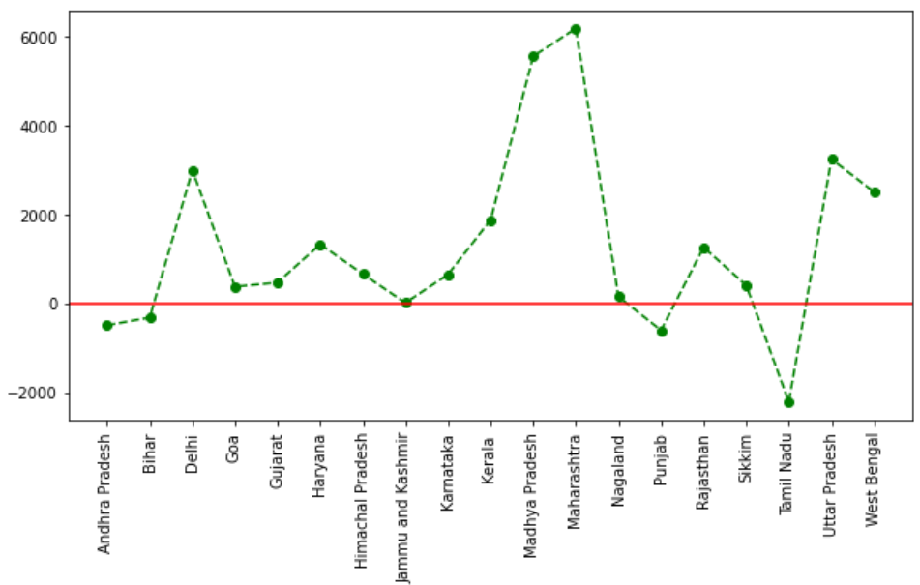
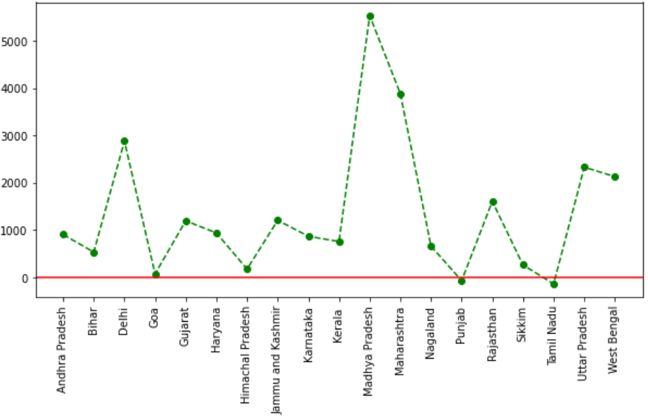
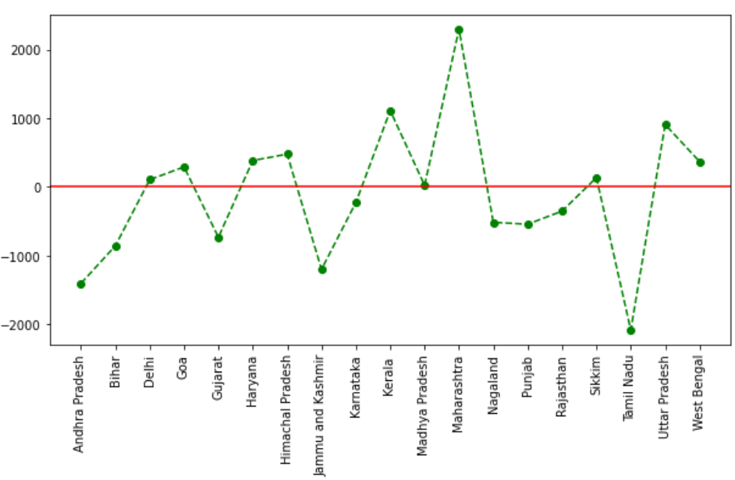
Profit Analysis in States
Tamil Nadu is facing a huge amount of loss which requires immediate attention.
Maharashtra and Madhya Pradesh are giving huge amount of profit.
2018 ----->2019
Tamil Nadu is not giving much loss.
Profit of goa has reduced from 2018 to 2019 so it also need attention.

Slide 7

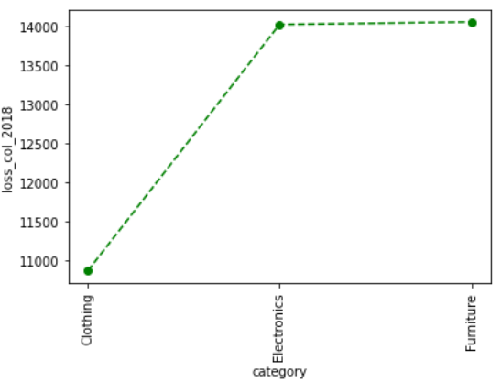
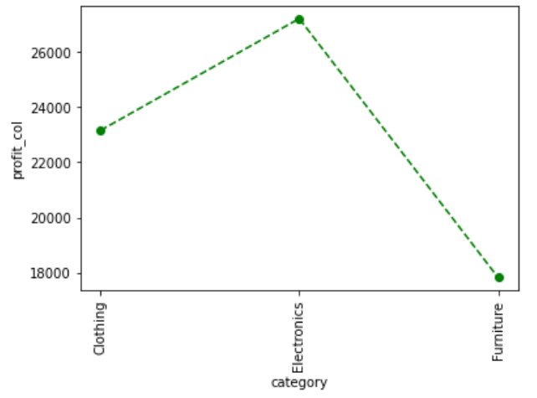
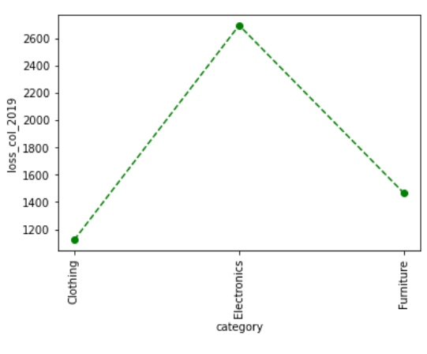
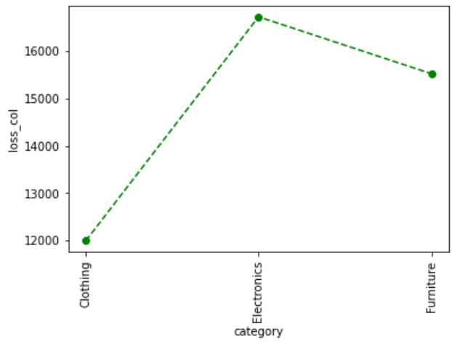
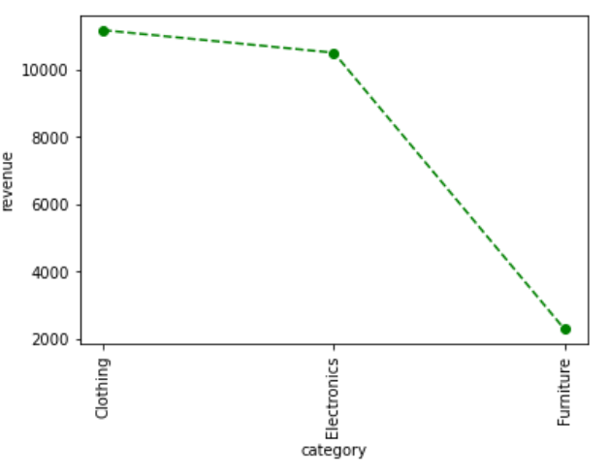
Analyzing the profit/loss in categories
So according to latest trend in year 2019 , loss in Furniture category has reduced but loss in Electronics has spiked.
Furniture category is having very less overall profit
Clothing category is showing decent behavior overall
Electronics Category has major share in loss

Slide 8
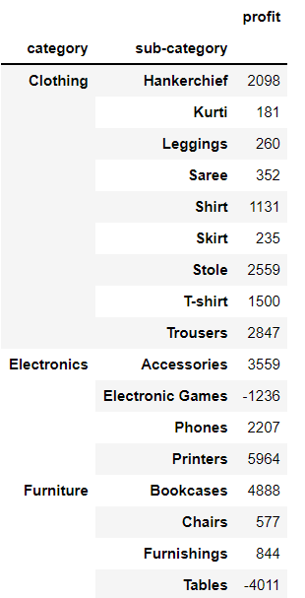
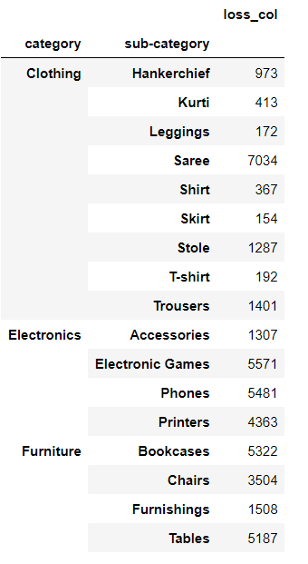
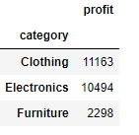
Let's Dive into Sub-categories now...
From total profit we can say that Electronic Games and Tables sub-categories are giving loss to the company.
Depicting Loss among various sub-categories
In Electronics Electronic games and phones are having high losses
In Clothing Saree is covering the major portion of the loss.
Clothing Category is contributing highest in the company
Highest contributing sub-categories are stole , Hankerchief and Trousers.
Furniture is least contributing ,
Bookcases are contributing highest and Tables are in loss.
In Furniture Bookcases and Tables are contributing highest in the loss

Slide 9
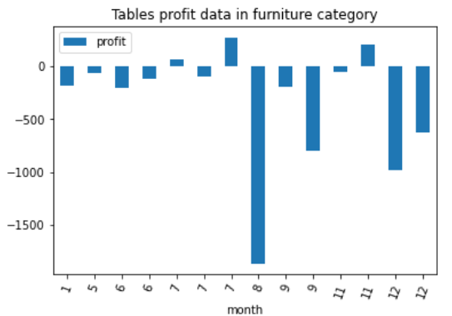
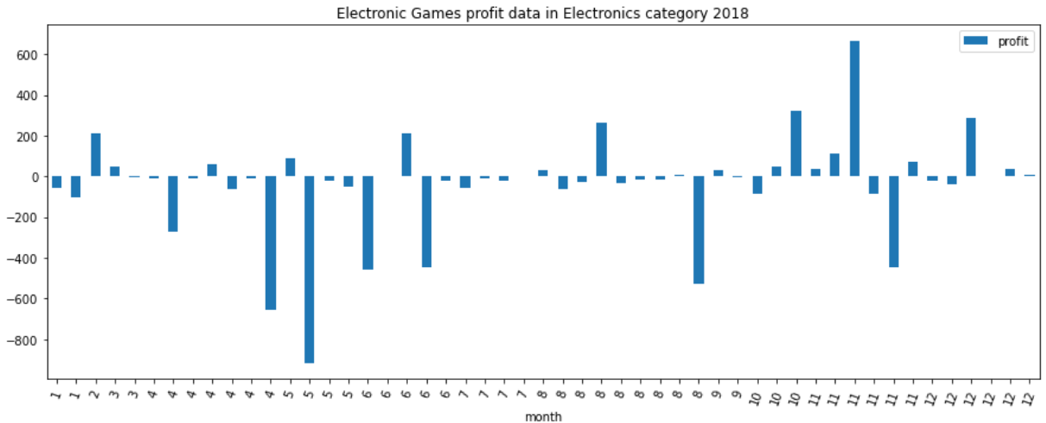
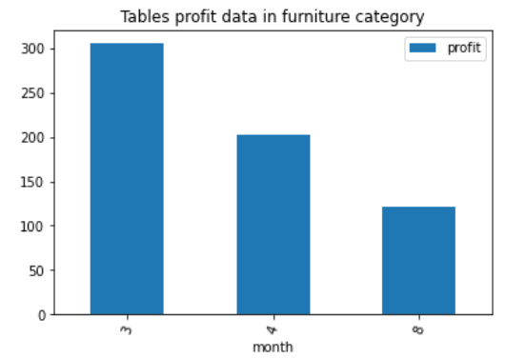
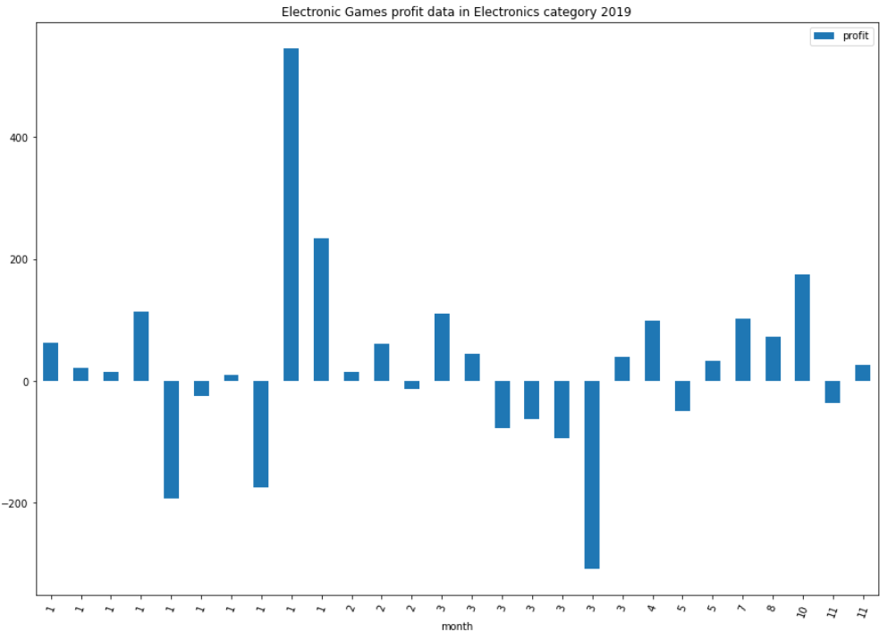
Specific Sub-Categories
2018
In 2019 Electronic Games has gained some profit as In 2018 that category has faced a loss of 4640
2019
Number of Orders has also decreased in 2019 in Tables
Improvement in Tables Profit from 2018 to 2019 .

Slide 10
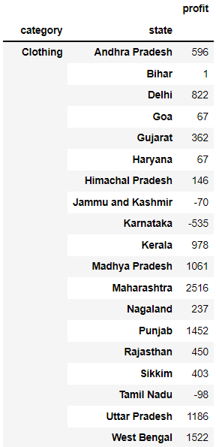
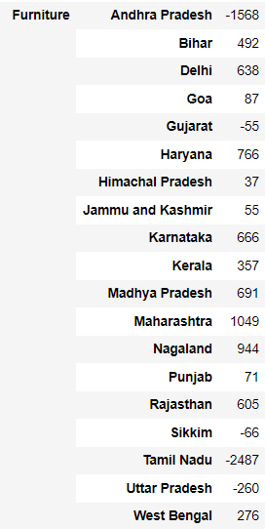
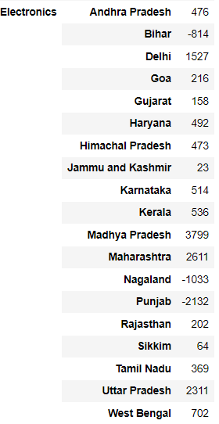
Analysis in states among different categories
In Clothing:-
Karnataka is giving huge loss and J&K and Tamil Nadu is also in loss.
In Furniture:
Andhra Pradesh ,Tamil Nadu are giving high loss and Gujarat is also in loss.
In Electronics:
Bihar ,Nagaland and Punjab are in loss.

Slide 11
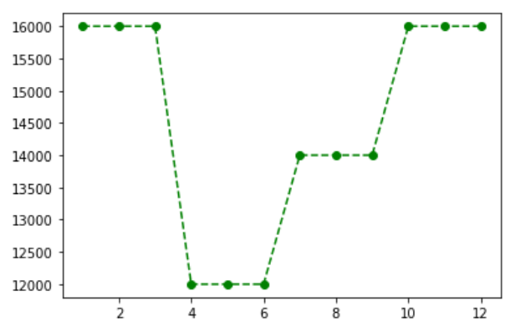
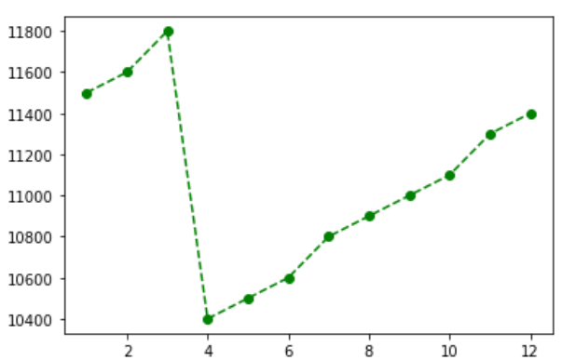
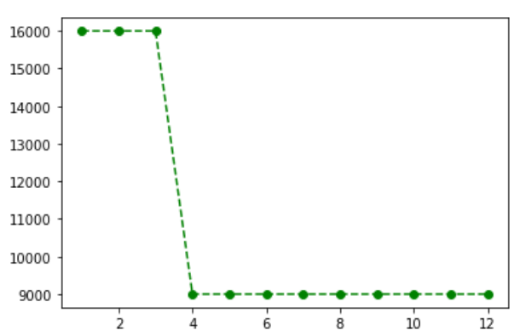
Sales Target Analysis
Target for first quarter is kept high followed by same target throughout the year.
It's surprising why even for year end the target is kept same instead of increased target.
sales target is fixed for each quarter.
For first quarter(Jan-Mar) and last quarter(Oct-Dec) it is high.
Second quarter is kept lowest followed by gradually increasing target for third quarter
Sales target are gradually increasing in first quarter followed by a dip at start of second quarter.
After second quarter it is gradually increasing.
After year end the targets increase immediately at the beginning of year.
CLOTHING
FURNITURE
ELECTRONICS

Slide 12
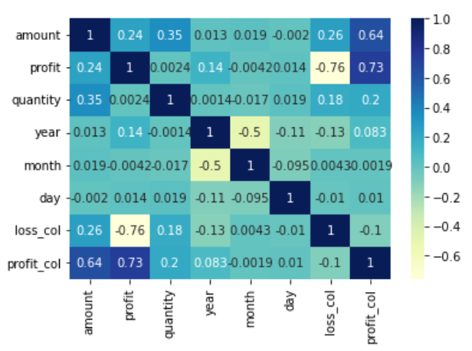
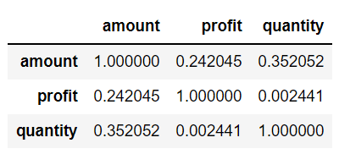
Correlation matrix

Slide 13

Presentation By:-
Tapish Sharma

